Slide 1
Iot training 2025 cohort 5 group 2 team 2
Presented by
Juan Jimenez
Magnus Eriksson
Vitor Medeiros
Yuvrajsinh Adajania

Slide 2




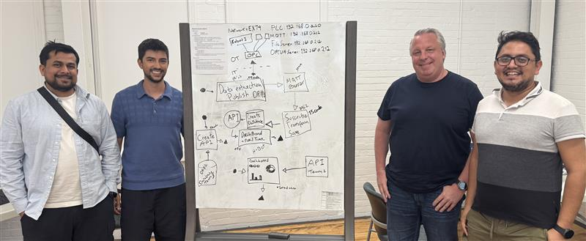
OUR TEAM
Juan Jimenez – IoT developer – Magna
Magnus Eriksson - Developer
Vitor Medeiros – Local divisional IT
Yuvrajsinh Adajania – Controls engineer

Slide 3
Project deliverables
Develop a Visual Representation Create a visual interface that displays the H-Bot robot's end-effector position over a graphical layout of the conveyor system.
Design an API using Team 3's Database Build a functional API that enables access and interaction with the data stored in Team 3’s database.
Implement a Visual Interface Using Team 1’s API Utilize the API developed by Team 1 to generate a dynamic visual representation of relevant system components or data.

Slide 4
Tools and technologies
💻 Development & Coding
Visual Studio Code – Main code editor
TypeScript – Language used for building services
HTML – Used to create the dashboard interface
🗃️ Data Management
pgAdmin – PostgreSQL database management and querying
Docker – Containerization for services and database deployment
📂 Version Control
GitHub – Code collaboration, version control, and repository hosting
📡 Communication & Integration​
OPC UA Server – Interface for robot data communication​
MQTT Broker – Lightweight messaging protocol for data transfer​
MQTT Explorer – Tool for visualizing MQTT topics and payloads
📊 Visualization & Dashboard
Grafana – Real-time data visualization and dashboard
Custom HTML Dashboard – Custom display for robot data
📋 Project Management
Jira – Task tracking and sprint planning
Confluence – Documentation and team collaboration

Slide 5



DEVELOP A VISUAL REPRESENTATION
SYSTEM ARCHITECTURE
OPC SERVER
MS1 - Publisher
MQTT Broker
MS2 - Ingestion
Database
Robot_data-team2 table
MS3 - API
DASHBOARD
Docker

Slide 6
2. Design an API for Team 3's Database
SYSTEM ARCHITECTURE​
Team's 3 Database
MS* - API

Slide 7

3. Implement a Visual Interface Using Team 1’s API
SYSTEM ARCHITECTURE​
Team's 1 MS - API
DASHBOARD

Slide 8
demonstration
Github
Docker
MQTT Explorer
Database (academy 07)
API
HBOT visualization dashboard
Secondary Dashboard using Team's 1 API / GRAFANA
API created using Team's 3 database

Slide 9
Challenges and lessons learned

Slide 10
THANK YOU

